Slide 1
Business Problem
In recent years, City Hotel & Resort Hotel have seen high cancellation rates. Each hotel is now dealing with a number of issues as a result, including fewer revenues & less than ideal hotel room use. Consequently, lowering cancellation rates is both hotel's primary goal in order to increase their efficiency in generating revenue, & for us to offer thorough business advice to address this problem.

Slide 2
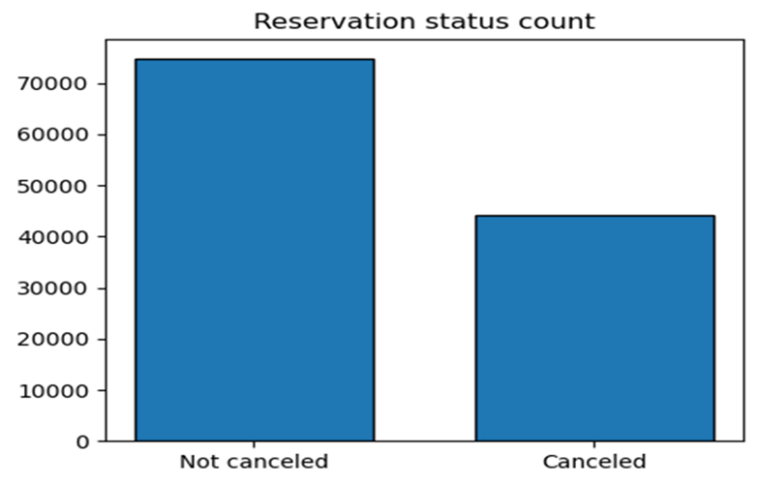
ANALYSES & FINDINGS:
The accompanying bar graph shows the percentage of reservations that are canceled and those that are not. It is obvious that there are still a significant number of reservations that have not been canceled. There are still 37% of clients who canceled their reservations, which has a significant impact on the hotel’s earnings.

Slide 3
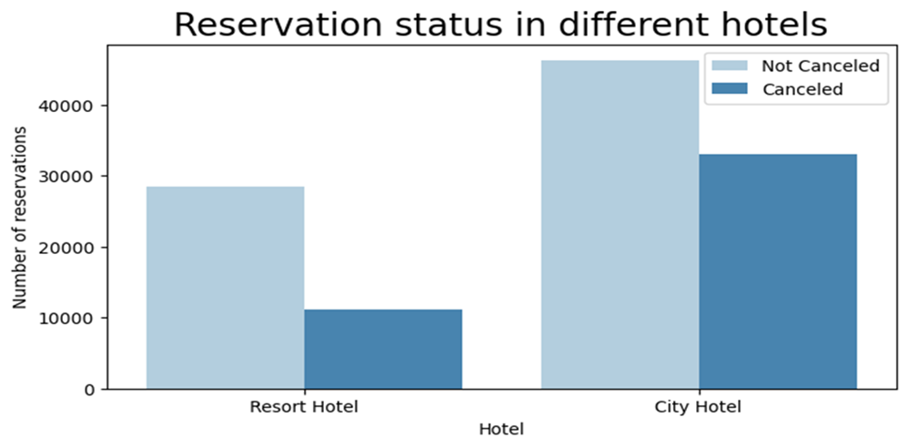
In comparison to resort hotels, city hotels have more bookings. It’s possible that Resort hotels are more expensive than those in cities.

Slide 4
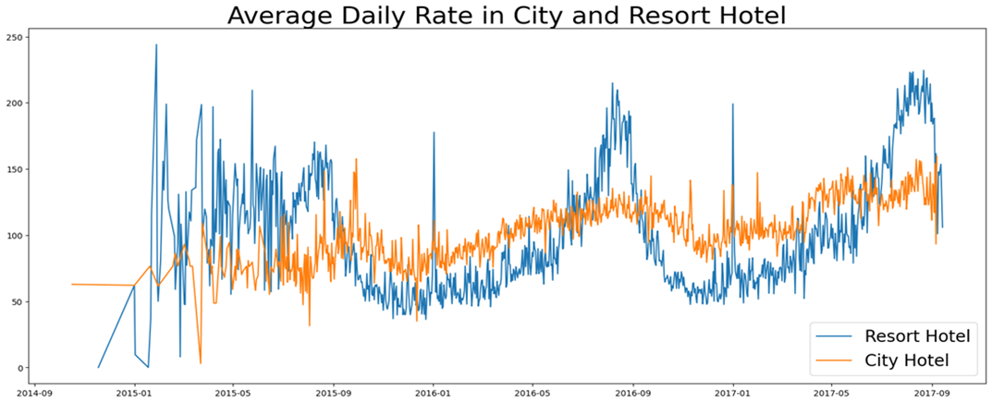
The line graph below shows that, on certain days, the average daily rate for a city hotel is less than that of a resort hotel, and on other days, it is even less. It goes without saying that weekends and holidays may see a rise in resort hotel rates.

Slide 5
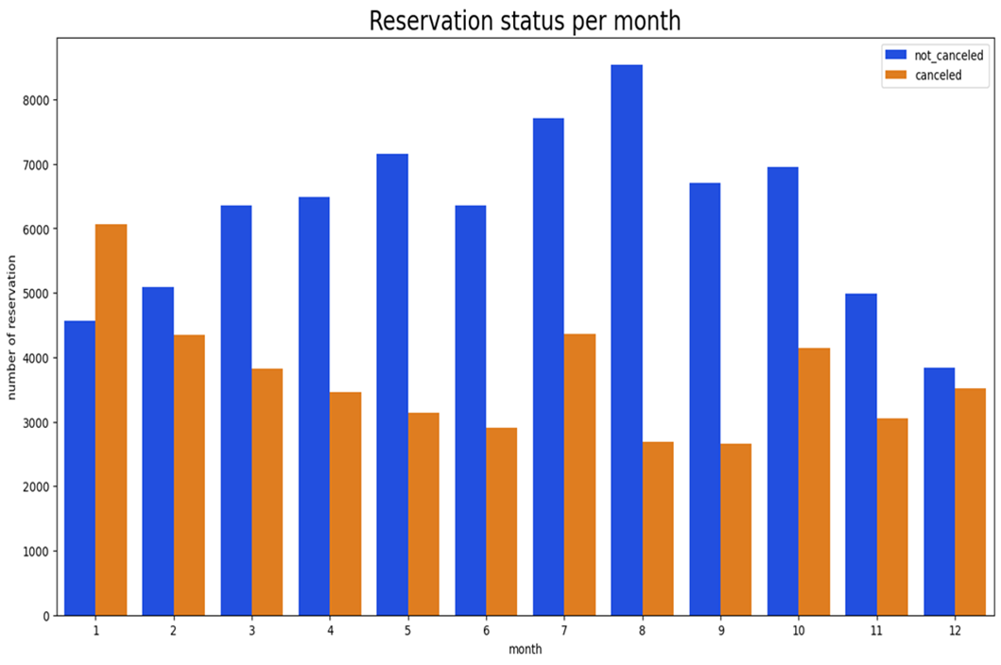
We have developed the grouped bar graph to analyze the months with highest and lowest reservation levels according to reservation status. As can be seen, August is the month with the greatest number of reservations and lowest cancellation, whereas January has the greatest number of cancellations.

Slide 6
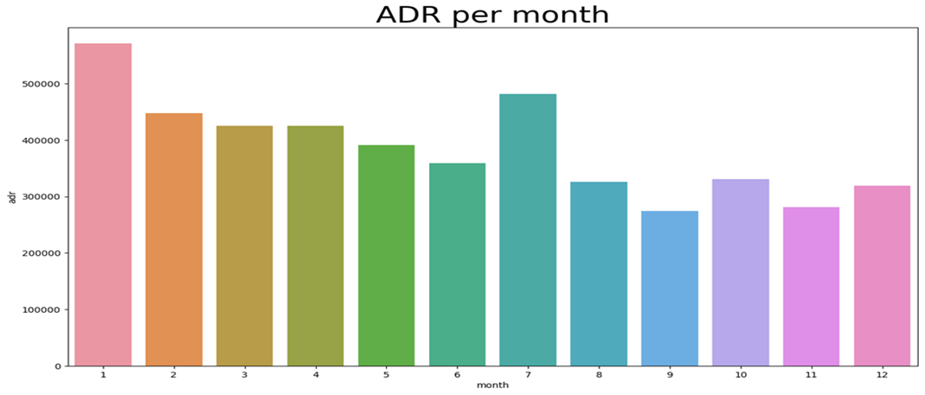
This bar graph shows that cancellations are most common when prices are greatest and are least common when prices are lowest. Therefore, the cost of the accommodation is solely responsible for the cancellations.

Slide 7
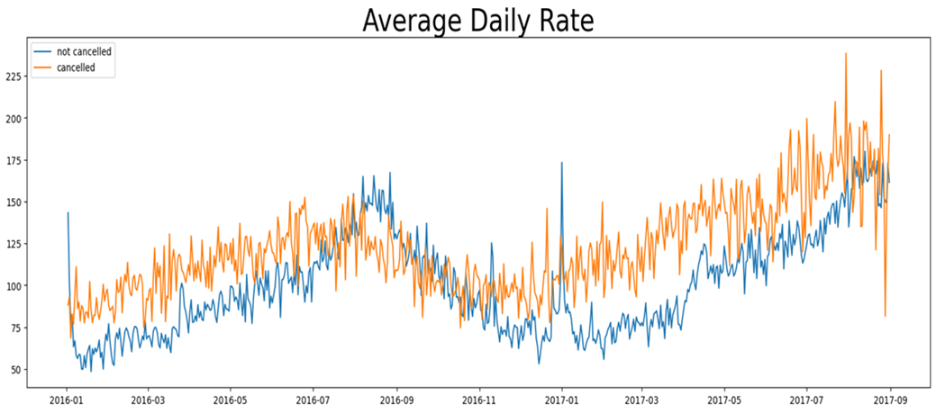
As seen from the graph, reservations are canceled when the average daily rate is higher than when it is not canceled. It clearly proves that higher prices lead to higher cancellation.

Slide 8
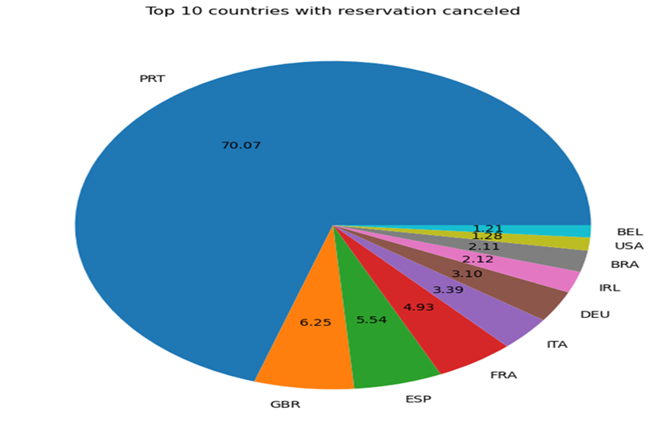
Now let’s see which country has the highest reservation canceled. The top country is Portugal with the highest number of cancellations.

Slide 9
SUGGESTIONS :
1. Cancellation rates rise as the price rises. In order to prevent cancellation of reservations, hotels could work on their pricing strategies and try to lower the rates for specific hotels based on locations. They can also provide some discounts to customers.
2. As the ratio of cancellation to non-cancellation of the resort hotel is higher than city hotels. So, city hotels should provide a reasonable discount on the room prices on weekends or on holidays.
3. In the month of January, hotels can start campaigns or marketing with a reasonable amount to increase their revenue as the cancellation is the highest in this month.
4. They can also increase the quality of their hotels and their services mainly in Portugal to reduce the cancellation rate.

Slide 10



